Slide 1
Automatic classification of legal texts
Authors:
Hao Peng
Kristin Day
Sanjana Pukalay

Slide 2
Motivation
Ultimate goal: Develop inexpensive platforms for legal text search that are available to the public.
Why does it matter:
We are all held responsible for the law but we do not have access to it.
one statute = one law
“the law” = all statutes + judicial opinions (also called “case law”)
Judicial opinions clarify the scope and meaning of statutes. They also fill in gaps (called “common law”).
Notes:
Westlaw uses 40 broad categorizations. They are hand crafted (called ”mark-up”) and the mark-up is regularly revised by hand as new opinions come in everyday from across the nation. One estimate stated that around 1000 new opinions are generated per state per day. Also, the average length of a judicial opinion is around 10 pages. (Thompson, 2001, p.70).

Slide 3
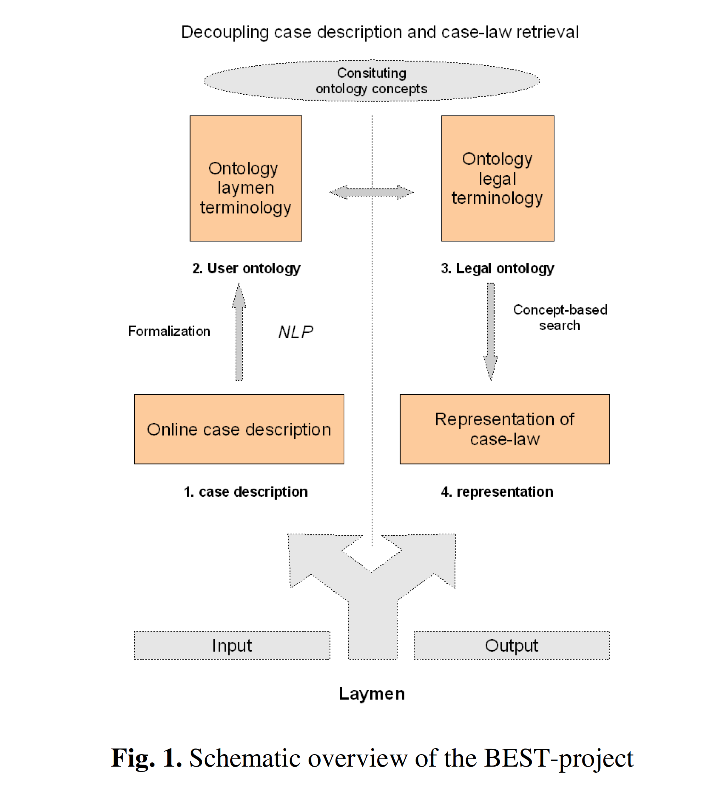
goals
Notes:
(Uijttenbroek, E.M., et al., 2016, p.292). The research in this article was used to attempt to give laypersons a better understanding of their liability based on the facts of their situation. This is often called “subrogation” and is a highly in-demand data analysis skill right now.

Slide 4
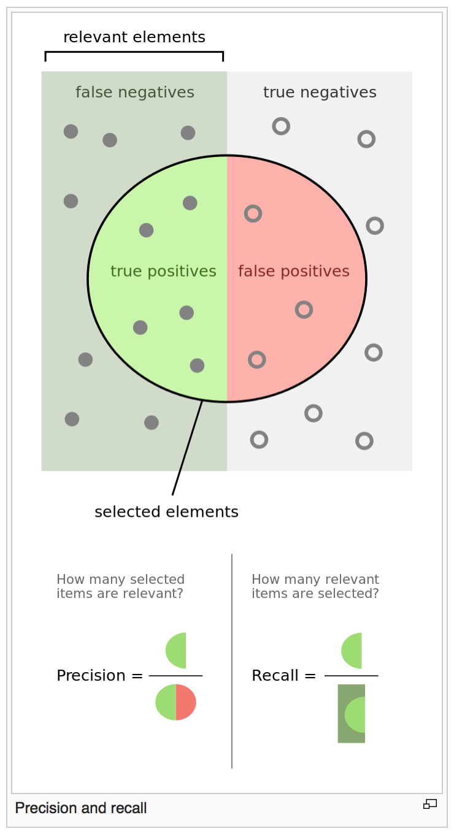
Recall more important than precision
Notes:
In law, it is more important to ensure that you don’t miss important cases than it is to prevent showing you cases that might not be relevant. Too much is better than not enough. (Thompson, 2001, p.71)

Slide 5
Existing methods
Currently all legal search databases controlled by private corporations who only contract for services business-to-business.
These corporations charge excessive fees based on labor intensive manual mark-up of each judicial opinion.
These searches require years of training to product accurate results.

Slide 6
Prior research
Legal language:
Long sentences and subclauses
Diverse language
Structured documents
Important problems:
Natural language understanding of document texts
User’s preferences

Slide 7
Prior Research – Cont’d
Types of Information Retrieval Systems:
Querying the legal database
Browsing/Navigation System
Question-Answer System – “What is the maximum driving speed allowed on a freeway?”

Slide 8
Prior research – cont’d
Common Retrieval Models:
Boolean
Vector Space
Probabalistic
Techniques:
SVM
Naïve Bayes
Decision Trees
K-Nearest Neighbors
Hidden Markov Model

Slide 9
data
“Judicial opinions” from Indiana and California
California 1655
Indiana 1087
250 hand labels in Excel spreadsheet

Slide 10
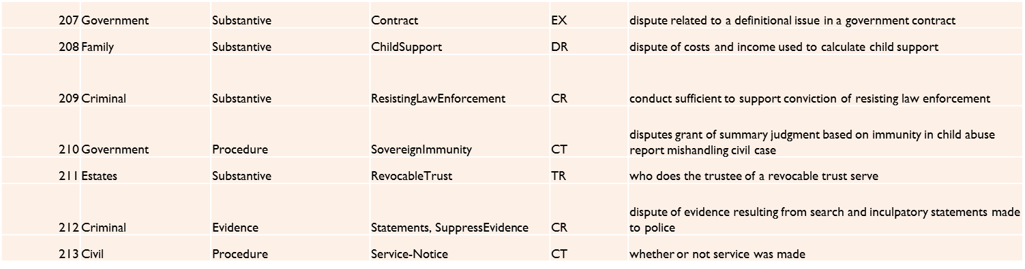
Hand labels
Hand labels in Excel spreadsheet – about 250 labeled IN Supreme Court Opinions

Slide 11
Methods
Semi-Supervised Learning
As we only labeled 250 out of (1087+1655) case files
Compared accuracy of the following model using Label Propagation semi-supervised learning algorithm in SK-learn:
Bag of Words
Bag of Means on pre-trained Word2Vec model

Slide 12
Evaluation

Slide 13
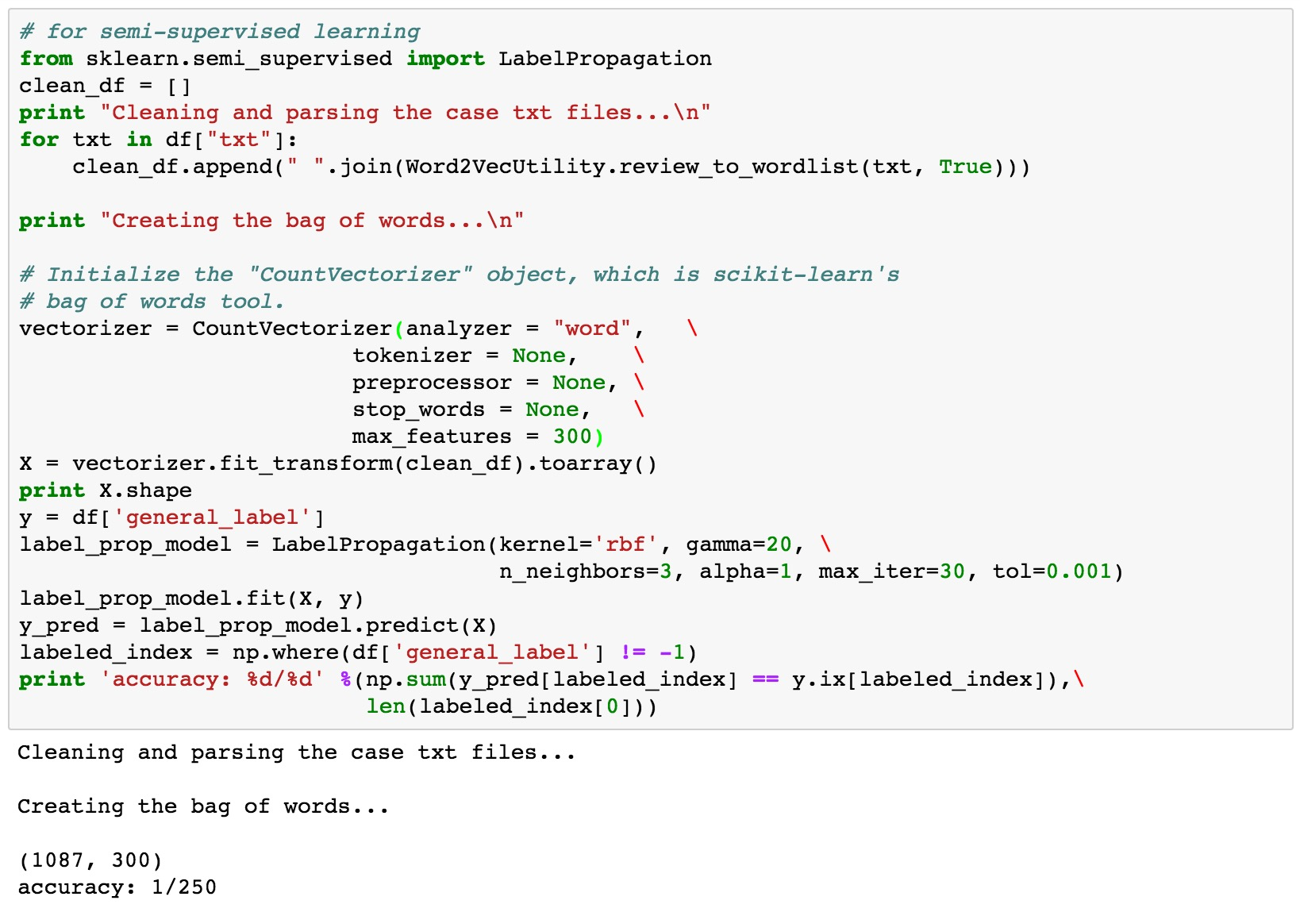
Accuracy of Bag of Word with Semi-supervised learning
* We set our vocabulary size to 300, thus each txt file is represented as a 300D vector, the same dimension as been used in the Word2Vec model.
*Out of all 250 case files that had been manually labeled by us, it only predicted one case file correctly !

Slide 14
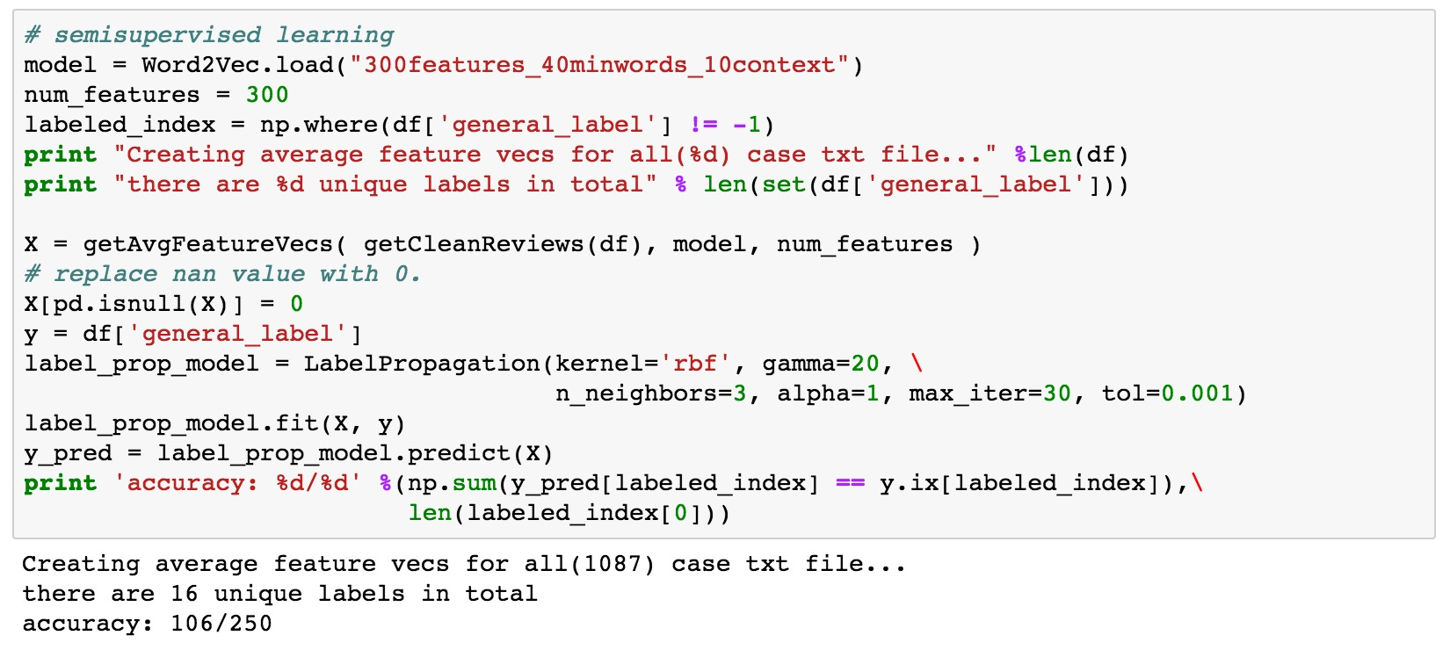
Accuracy of Bag of Means on Word2Vec with Semi-supervised learning
*It correctly classified 106/250 case files! Significantly better than Bag of Word model.

Slide 15
Conclusion
It is difficult to find comparable baselines from related research.
To date, I can find no studies that use Word2Vec semi-supervised learning methods to classify legal texts.
In other articles that have discussed classification of legal texts, accuracy measures are not given.
I can find recall and precision statistics from classification research, but the numbers are associated with the query success as opposed to the classification success. Those numbers range from around 25% to 66% for around 18 topics.
Given the number of topics we used in these experiments (16), the baseline for guess would be 6.25% (1 in 16 change of guessing the category correctly).

Slide 16
Thank you

Slide 17
Citations
Thompson, P. "Automatic Categorization Of Case Law." Proceedings Of The International Conference On Artificial Intelligence And Law Proceedings of the 8th International Conference on Artificial Intelligence and Law, ICAIL '01 (2001): 70-77. Scopus®. Web. 23 Apr. 2016.
Uijttenbroek, E.M., et al. Retrieval Of Case Law To Provide Layman With Information About Liability: Preliminary Results Of The BEST-Project. n.p.: 2007. Scopus®. Web. 23 Apr. 2016.
West Publishing Company. West's Analysis of American Law. West Publishing Company, St. Paul MN, 1994.
West Publishing Company. West's Law Finder: A Legal Resources Guide. West Publishing Company, St. Paul, MN, 1995.

